Slide 1
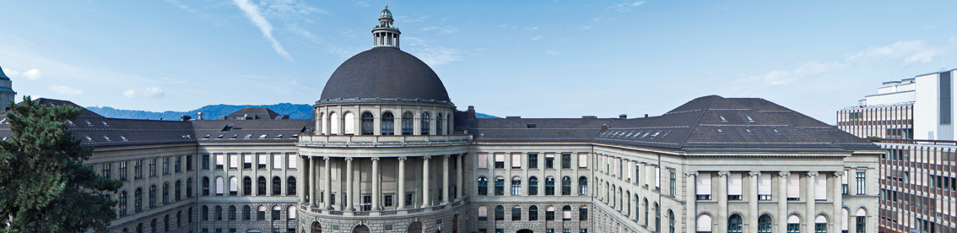
XXX
3D Vision Paper Presentation by Varin Buff, Gian-Andrea Heinrich, Björn Joos, Robin Stähli

Slide 2
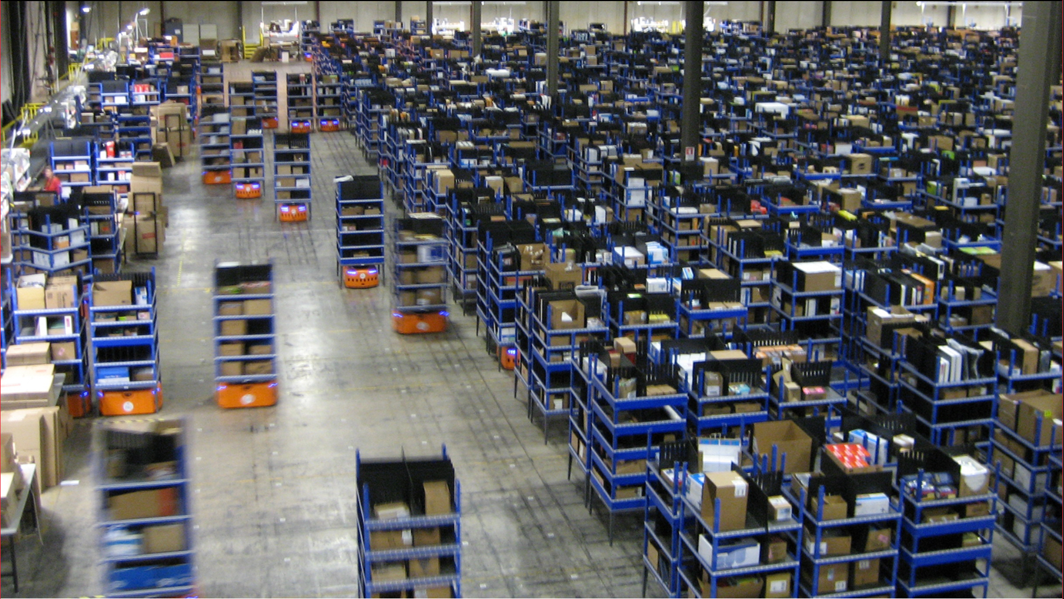
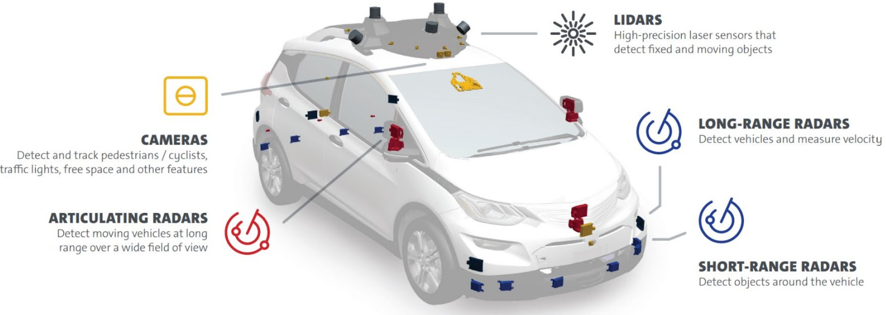
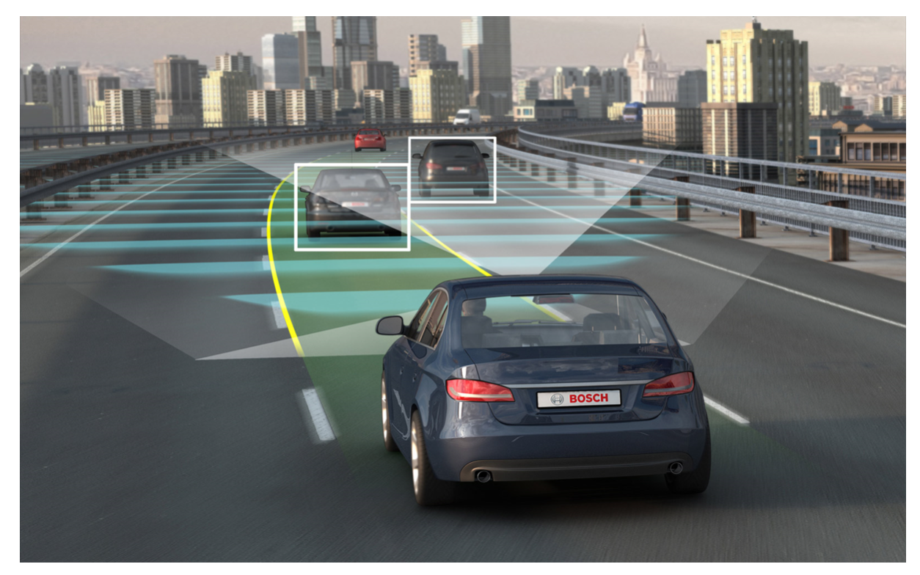
Why is it important?
In Industry 4.0 and in the car of the future navigation is crucial
Vision based navigation by reinforcement learning allows to use relay on cameras instead of expensive large and heavy high-tech gear.
http://urbanizehub.com/wp-content/uploads/2017/10/kiva.jpg (11.03.2018)
http://scet.berkeley.edu/cities-autonomous-vehicles/ (11.03.2018)
http://image-sensors-world.blogspot.ch/2018/01/gm-self-driving-car-has-5-lidars-and-16.html (11.03.2018)
Notes:
Erklären wieso wichtig → z.B. Lagerroboter in modernem Lagerhaus
Auto im Stadtverkehr
Einsparungen an Sensoren → Platz und Kosten

